Slide 1





Persona – The Artificial HR
Team
Limitless Loop
Hackathon
TechClasher @ GNIOT
College
Greater Noida Institute of Technology (GNIOT)
Members
→ Divyanshu Shekhar
→ Harshit Garg
→ Khushman Kaur

Slide 2
Our Proposed Solution
Problem statement
Core Innovation
Key Features
Interviews are subjective and depend heavily on the interviewer's perception. Candidates rarely get actionable feedback on Soft Skills . There’s a critical need for AI-accurate, data driven assessment technologies for improving job readiness.
Introducing an AI-powered interview assessment system that leverages computer vision and behavioral analysis to provide real time scoring on attire , body language and soft skills.
→ Real time body language, gestures and attire detection
→ Commonly asked questions data paired with soft skills needs
→ AI powered evaluation are instant analysis reports.
Platform Flow
The flow is designed to be real-time fast while providing analysis as accurate as possible without mixed perceptions:
Submit minimal info → Soft skills assessment → (System) Capture cam for evaluation → Provide analysis

Slide 3

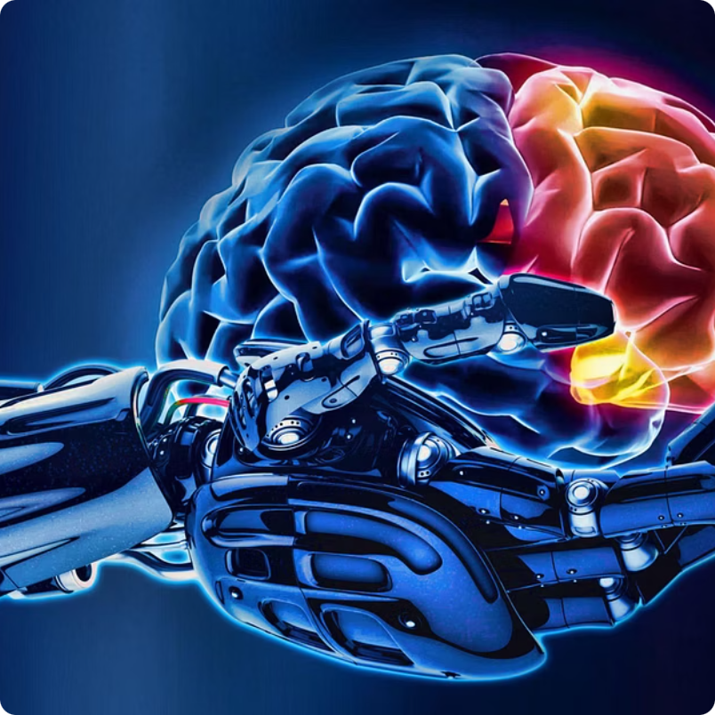

Technical Approach
Architecture
AI & Model Pipeline
Performance & Reliability
Frontend: Next.js + WebRTC for real-time camera feed & user interaction
Backend: Django REST for ML requests & analysis generation
Deployment: Containerized deployment on cloud-native systems for simultaneous access
Vision: MediaPipe + CLIP/BLIP for body language, gesture & attire analysis
Speech: Whisper + HuggingFace Transofrmers for spoken soft-skills evaluation
LLM Layer: Groq for structured, human-readable and intuitive feedback synthesis
Modular model design enabling independent updates & fine-tuning
Low-latency pipeline and flow optimized for real-time feedback
Scalable & cloud-ready architecture supporting multiple simultaneous sessions and combined data management

Slide 4
Feasibility & Viability
Technical Feasibility
Market Viability
→ Proven stack using battle-tested modern technologies
→ Growing demand for AI-driven recruitment tools.
Feasible using CV and NLP libraries (MediaPipe, PyTorch, HuggingFace)
Larger target audience : universities, hiring firms , corporate HR teams
Minimalist and easy-to-use and build with powerful web technologies: Next.js (Frontend), Django (Backend)
Competitive advantage : Real-time, multi-parameter evaluation vs. standard MCQ.
Modular ML models and LLMs with large datasets:
BLIP, CLIP, Google Gemini
Large target audience : universities, hiring firms, corporate HR teams
We have a clear roadmap for development, deployment, and adoption in both academic and corporate recruitment.

Slide 5

Impacts & Benefits
Candidate Impact
Personalized, structured improvement feedback which also removes ambiguity & anxiety from assessment.
Bridges the gap between academia and industry readiness
Recruiter Impact
Objective shortlisting, improved bias mitigation. Saves many hours of manual evaluation
Promotes fair opportunity in recruitment regardless of background and perception
Environmental Sustainability
Indirect reduction of waste and promoting eco-friendly practices through reduced travel. By enabling high-quality remote practice and optimizing the Screening funnel. We help decrease the need for early-stage physical interviews , leading to low carbon emission from candidates and recruiter travel.
Our solution aims to create a positive ripple effect across multiple dimensions.

Slide 6





Research & References
Demand of AI personalization
AI Impact on Recruitment
→ The LinkedIn Workplace Learning Report (2024) showed us that employees increasingly demand AI personalized career development and soft skills are surging in importance.
→ AI adoption in recruitment is rising – screening, evaluation and filtering are being automated as per the Psico-Smart Blog. Bias remains a significant risk to recruitment.
Hiring Top Talent – A Challenge
The Tech Backing
→ This SHRM blog highlights how organizations struggle to hire quality candidates, and trends indicate that 33% candidates don’t have the right skills required
→ Google’s Research blog on MediaPipe shows how real-time body tracking can be done efficiently on-device or in low latency with details such as methods, tradeoffs and optmizations.

Slide 7


Conclusion
The Impressions
Persona offers a transformative approach to job-readiness and equitable talent discovery. By providing objective, data-driven feedback on non-verbal communication, We demonstrate significant advancements in boosting candidate confidence and reducing bias in the pre interview process.
0ur \/ision
Our vision is to empower careers throught objective, AI-driven insights and to build a bridge between human potential and AI precision.
Thank you for your time and consideration.
– Team Limitless Loop

